Slide 1
Employee Management system

Slide 2
ABOUT US
TEAM MEMBERS
G.Rakesh
Linkedln
B.Tech : CSE & AI ML
T.Rami Reddy
Linkedin | GitHub
B.Tech : CSE-DS

Slide 3
Project Agenda – Employee Management System
Introduction
Domain Knowledge
ER Diagram
Key Analysis use case
Sample SQl Queries
Experience & Challenges
Conclusion
Q & A

Slide 4
Introduction
Employee Management System
The Employee Management System (EMS) is a relational database application developed using SQL to efficiently manage employee information within an organization.
The database consists of six interconnected tables: JobDepartment, SalaryBonus, Employee, Qualification, Leaves, and Payroll. These tables work together to manage employee information, calculate payroll, track leave records, and generate meaningful reports for decision-making.
The system stores and manages:
Employee Details
Job Departments
Salary bonus
Qualifications
Leave Records
Payroll Information

Slide 5
Domain Knowledge
The EMS consists of six major modules:
Employee Information Management
Department & Job Role Management
Payroll Management
Qualification Tracking
Leave Management
Salary & Bonus Management
These modules help HR efficiently manage employees and support informed business decisions.

Slide 6
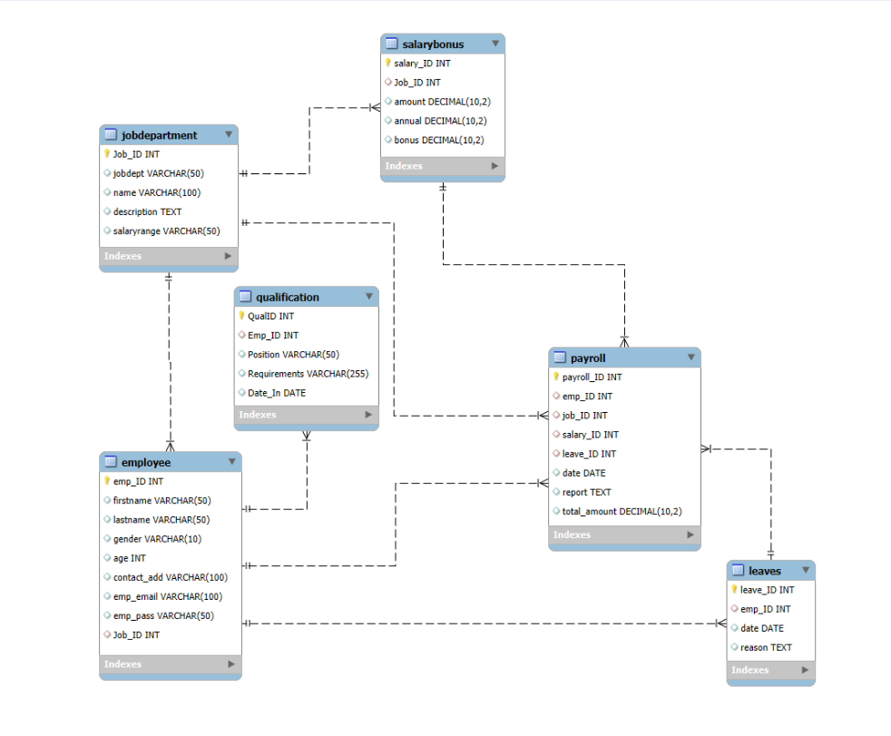
System Design Overview
ER Diagram:

Slide 7
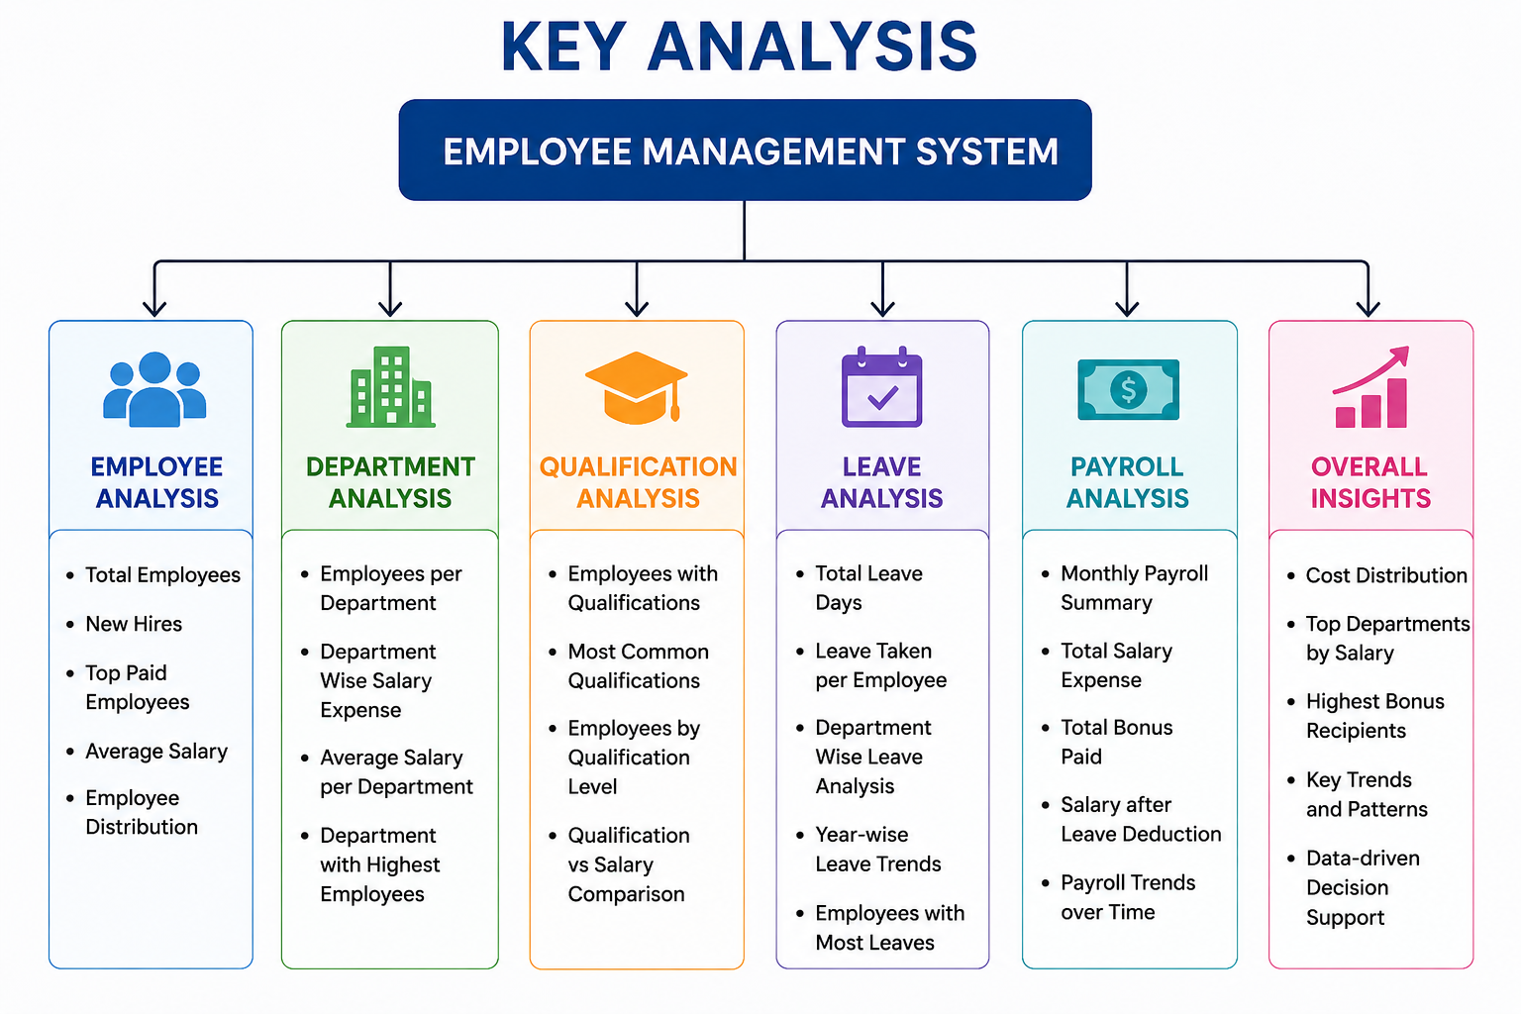
key Analysis Use Cases – Employee Management System

Slide 8


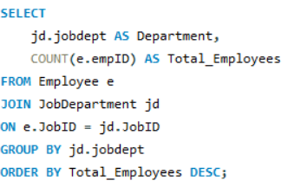
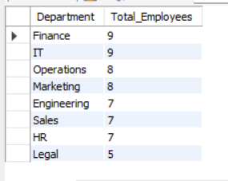
Sample SQL Queries
1.How many unique employees are currently in the system?
2.which departments have the highest number of employees?
COUNT(DISTINCT emp_ID) counts all unique employee IDs. DISTINCT ensures duplicate IDs are not counted. FROM Employee retrieves data from the Employee table.
JOIN connects Employee and JobDepartment using Job_ID. COUNT() counts employees in each department. GROUP BY groups employees department-wise. ORDER BY DESC displays departments from highest to lowest employee count.

Slide 9
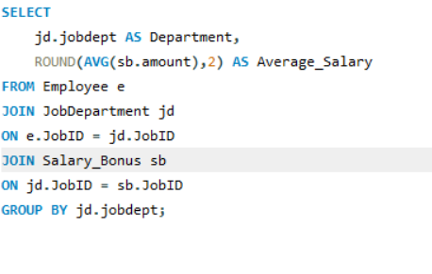
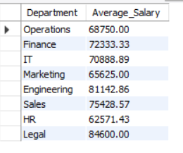
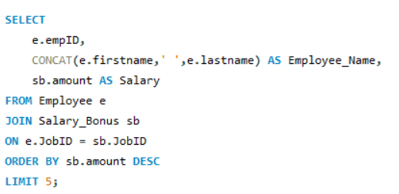
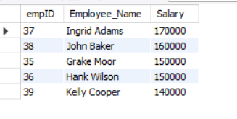
3. What is the average salary per department?
Joins Employee, JobDepartment, and SalaryBonus tables. AVG(amount) calculates the average salary. GROUP BY calculates department-wise averages.
4.Who are the top 5 highest-paid employees?
Combines first and last names using CONCAT(). Retrieves salary information. ORDER BY DESC sorts salaries from highest to lowest. LIMIT 5 displays only the top five employees.

Slide 10
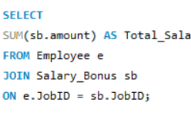

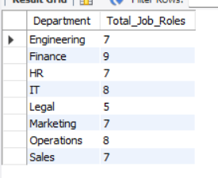
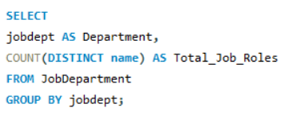
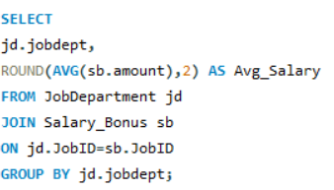
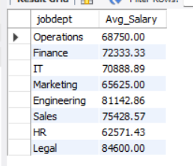
5.What is the total salary expenditure across the company?
SUM() adds all employee salaries. Joins Employee and SalaryBonus tables.
6.How many different job roles exist in each department?
Counts unique job roles in each department. Groups the data by department.
7.What is the average salary range per department?
Calculates average salary for each department. Uses the SalaryBonus table.

Slide 11
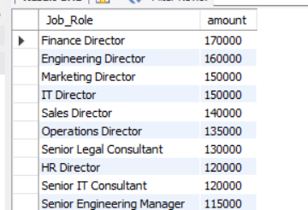
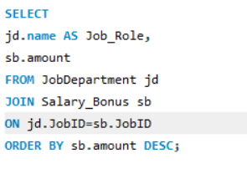
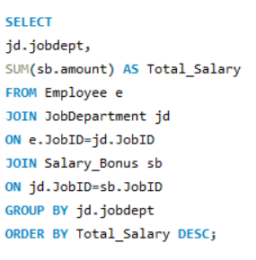
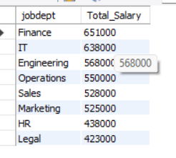
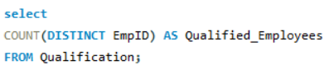

8.Which job roles offer the highest salary?
Retrieves each job role and its salary. Sorts salaries in descending order
9.Which departments have the highest total salary allocation?
Calculates the total salary allocated to each department. Uses SUM() with GROUP BY.
10.How many employees have at least one qualification listed?
Counts employees who have at least one qualification

Slide 12
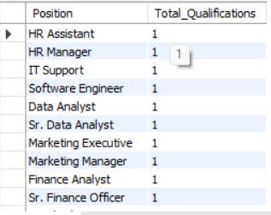
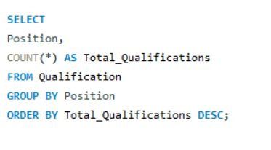
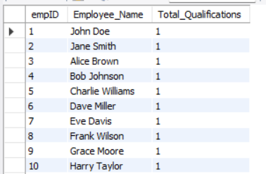
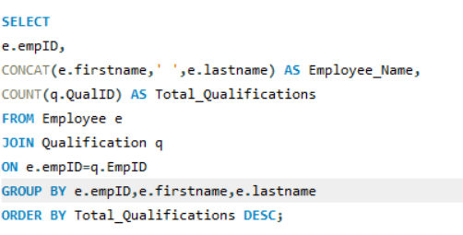
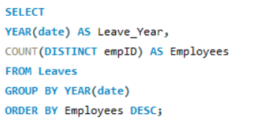

11.Which positions require the most qualifications?
This query identifies job positions that require higher educational qualifications or certifications.
12.Which employees have the highest number of qualifications?
This query identifies employees with the most qualifications. It helps recognize highly skilled employees.
13.Which year had the most employees taking leaves?
This query groups leave records by year.

Slide 13
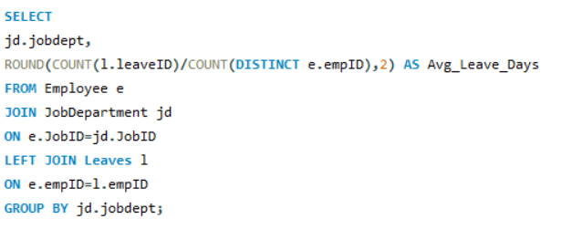
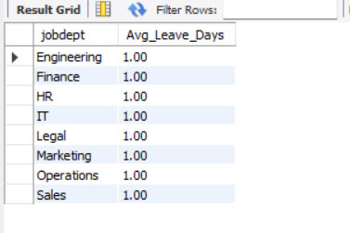
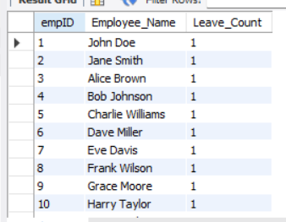
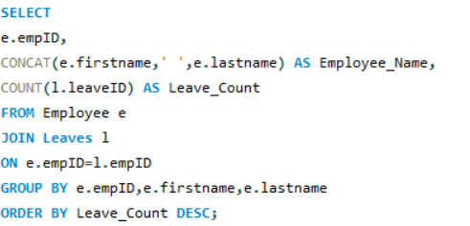

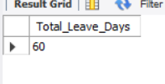
14.What is the average number of leave days taken by its employees per department?
"This helps compare leave patterns between departments and identify departments with higher absenteeism."
15.Which employees have taken the most leaves?
This query identifies employees with the highest leave count.
16.What is the total number of leave days taken company-wide?
"This provides the total leave days taken across the organization and helps HR evaluate overall employee attendance."

Slide 14
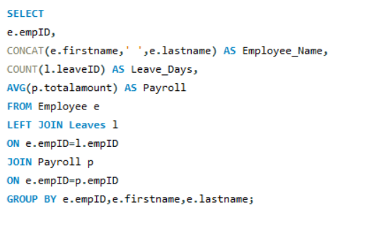
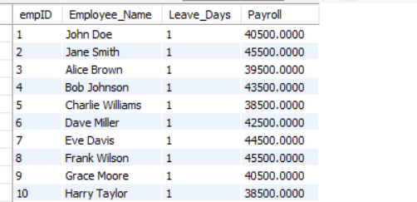
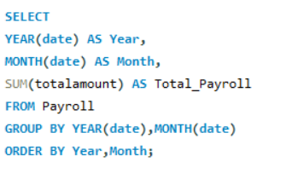
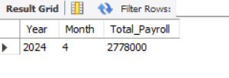
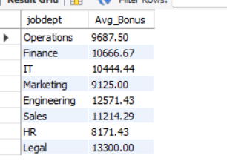
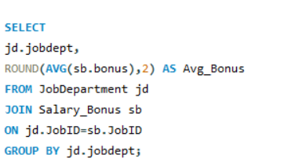
17.How do leave days correlate with payroll amounts?
18.What is the total monthly payroll processed?
19.What is the average bonus given per department?

Slide 15
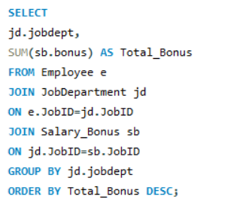
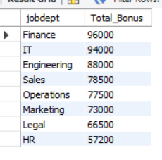
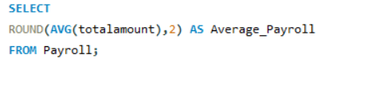

20.Which department receives the highest total bonuses?
21.What is the average value of total_amount after considering leave deductions?

Slide 16
Experiences & Challenges
Challenges Faced:
Here are some Challenges Faced that you can include in your Employee Management System (EMS) SQL project report or presentation:
Designing the database schema and establishing correct relationships between tables.
Implementing primary keys and foreign keys to maintain data integrity.
Avoiding duplicate records by using unique constraints on important fields such as employee email.
Writing complex SQL queries involving multiple table joins (Employee, Payroll, Leaves, Qualification, and JobDepartment).
Calculating aggregate values such as total salary, average salary, bonuses, and employee counts accurately.

Slide 17
Learning Experience:
Through the Employee Management System (EMS) SQL project, I gained practical experience in designing and managing a relational database. The project helped me understand how different tables are connected using primary and foreign keys, ensuring data integrity and consistency.
I learned to write SQL queries for data retrieval, filtering, sorting, grouping, and aggregation. I also gained hands-on experience using JOINs, GROUP BY, ORDER BY, COUNT, SUM, AVG, DISTINCT, and other SQL functions to generate meaningful business insights.
Working on this project improved my ability to analyze employee, department, payroll, leave, and qualification data. It also enhanced my problem-solving skills by debugging SQL errors, optimizing queries, and validating query results.

Slide 18
Conclusion
Successfully developed an Employee Management System using SQL.
Organized employee data with a structured relational database.
Generated meaningful insights through SQL queries.
Improved practical knowledge of database management

Slide 19
Q & A

Slide 20
THANK YOU

